Slide 1









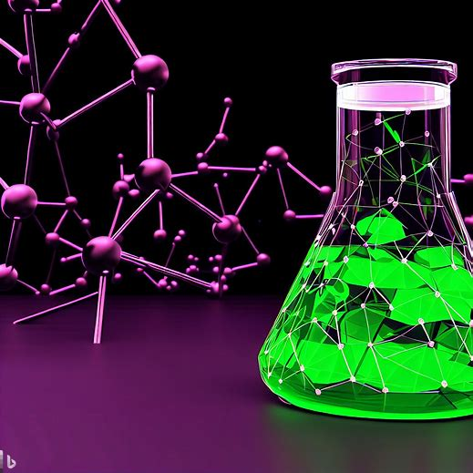


2nd International Conference
on Chemo and BioInformatics
2nd International Conference
on Chemo and BioInformatics
September 28-29, 2023, Kragujevac, Serbia
The influence of structural modification of Pd(II) pincer-type complexes
on the kinetic of the substitution reactions
Snežana Jovanović Stević¹, Snežana Radisavljević², Aleksandar Mijatović³, Biljana Petrović², Ana Kesić^{4,*}
¹ University of Kragujevac, Faculty of medical science, Department of pharmacy, 34000 Kragujevac, Serbia, S. Markovića 69;
e-mail: snezanaj@kg.ac.rs
² University of Kragujevac, Faculty of science, 34000 Kragujevac, Serbia, R. Domanovića 12,
e-mail: snezana.radisavljevic@pmf.kg.ac.rs, biljana.petrovic@pmf.kg.ac.rs
³ University of Belgrade, Faculty of mining and geology, 11000 Belgrade, Serbia, Djušina 7,
e-mail: aleksandar.mijatovic@rgf.bg.ac.rs
4 University of Kragujevac, Institute for information technologies, 34000 Kragujevac, Serbia, J. Cvijića bb,
e-mail: akesic@uni.kg.ac.rs
Abstract: The kinetic data obtained for the substitution reactions of some palladium(II) complexes containing bis-pyrazolylpyridine derivatives as pincer-type ligands with biologically significant nitrogen- and sulfur-donor biomolecules are presented here. Three structurally different palladium(II) complexes were selected [Pd(L1)Cl]⁺ (Pd1), [Pd(L2)Cl]⁺ (Pd2) and [Pd(L3)Cl]⁺ (Pd3) (where L1 = bis(2-(1H-pyrazol-1-yl)ethyl)amine, L2 = 2,6-bis(5-(tert-butyl)-1H-pyrazol-3-yl)pyridine and L3 = 2,6-bis(5-(tert-butyl)-1-methyl-1H-pyrazol-3-yl)pyridine, while for the entering nucleophiles were used thiourea (Tu),
L-methionine (L-met) and guanosine-5’-monophosphate (5’-GMP). Kinetic measurements were carried out for all systems as pseudo-first order reactions (at least 10 times of the ligand in excess relative to the complex) under physiological conditions using stopped-flow UV-Vis spectrophotometer. By comparing the published results for the second-order rate constant, it was established the relationship between the structural properties of the complexes and their reactivity towards selected nucleophiles. This overview shows that tuning the lability of the inert ligands through steric and electronic (σ-donor and π-acceptor) effects, the biological behavior of the complexes can be significantly changed.
Figure 1. The structures of complexes
Table 1. Second-order rate constants for the substitution reactions of Pd1-Pd3 complexes with selected nucleophiles. pH 7.2 and 37 ⁰C
Complex | Ligand | k₂ [M⁻¹ s⁻¹] | Ref.
Pd1 | Tu | 432 ± 4 | [1]
 | L-met | 186 ± 4
 | 5’-GMP | 30 ± 1
Pd2 | Tu | 23100 ± 700 | [2]
 | L-met | 12200 ± 100
 | 5’-GMP | 760 ± 20
Pd3 | Tu | 18400 ± 200 | [2]
 | L-met | 10100 ± 100
 | 5’-GMP | 650 ± 20
Figure 2. The structures of ligands
Conclusions:
The rate of the substitution reactions of metallocomplexes with biologically important molecules can be controlled by the suitable choice of inert chelating ligand. Thus, the chemical nature of the inert tridentate ligands that combine electronic and steric effects has very important role in the prediction of the kinetic behavior of some transition metal ion complexes. Information presented here can provide deeper insights into the possible use of kinetics studies as tools for development of new metallodrugs.
References:
[1] R.O. Omondi, A.O. Fadaka, A.A. Fatoku, D. Jaganyi, S.O. Ojwach, Synthesis, substitution kinetics, DNA/BSA binding and cytotoxicity of tridentate N^E^N (E=NH, O, S) pyrazolyl palladium(II) complexes, Journal of Biological inorganic chemistr, 27 (2022) 653-664.
[2] D. Ćoćić, S. Jovanović, S. Radisavljević, J. Korzekwa, A. Scheurer, R. Puchta, D. Baskić, D. Todorović, S. Popović, S. Matić, B. Petrović, New monofunctional platinum(II) and palladium(II) complexes: Studies of the nucleophilic substitution reactions, DNA/BSA interaction, and cytotoxic activity, Journal of Inorganic Biochemistry, 189 (2018) 91-102.

